Slide 1


Chicago Crime Analysis Project
Types and location of criminal incidents in 2020

Slide 2
Introduction
The purpose of this project is to examine types of criminal incidents in Chicago in 2020, and to identify where those incidents occurred
All the analyses were completed using Python

Slide 3
Data
Dataset was obtained from Chicago Data Portal: https://data.cityofchicago.org/Public-Safety/Crimes-2001-to-Present/ijzp-q8t2
This dataset contains reported incidents of crime (with the exception of murders where data exists for each victim) that occurred in Chicago in 2020
In total, 208,866 incidents were reported in 2020
Any incidents that did not have Lat/Long values were removed, since those values would be necessary in later analyses
The number of incidents after removing those rows was 207,525
I divided the dataset into two groups: “Arrests were made (32,993 incidents)” and “Arrests were NOT made (174,532 incidents)”

Slide 4
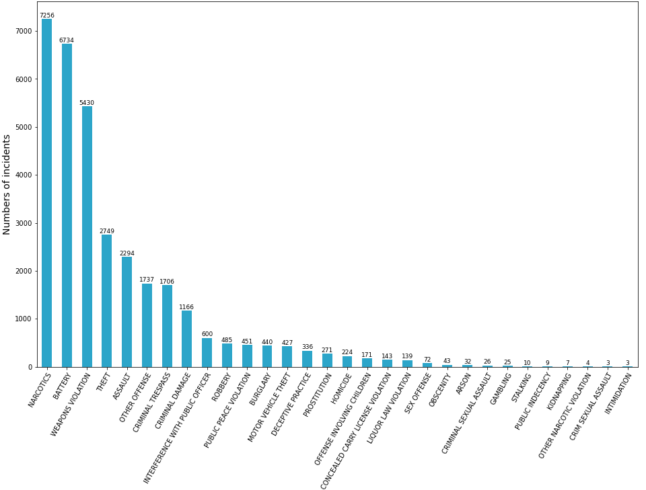
Types of Incidents in Chicago Where Arrests were Made in 2020

Slide 5
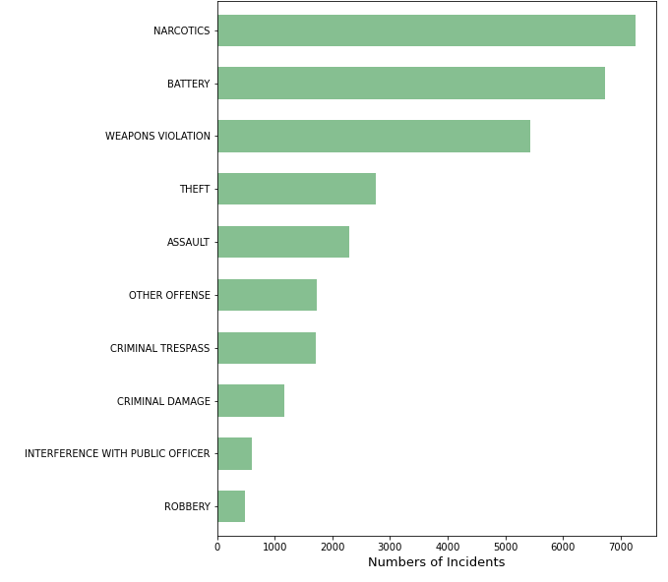
Top 10 Types of Incidents in Chicago Where Arrests were Made

Slide 6
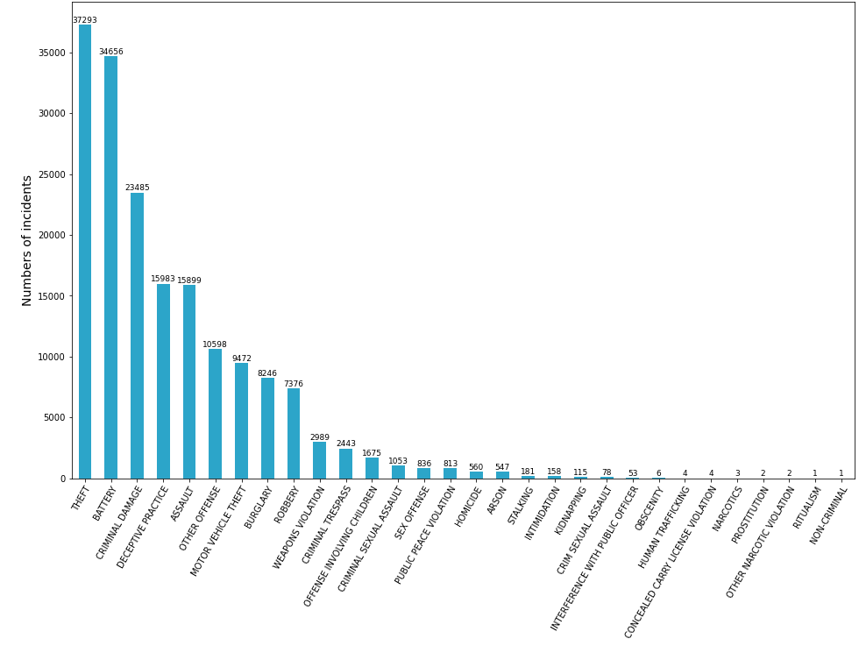
Types of Incidents in Chicago Where Arrests were NOT Made in 2020

Slide 7
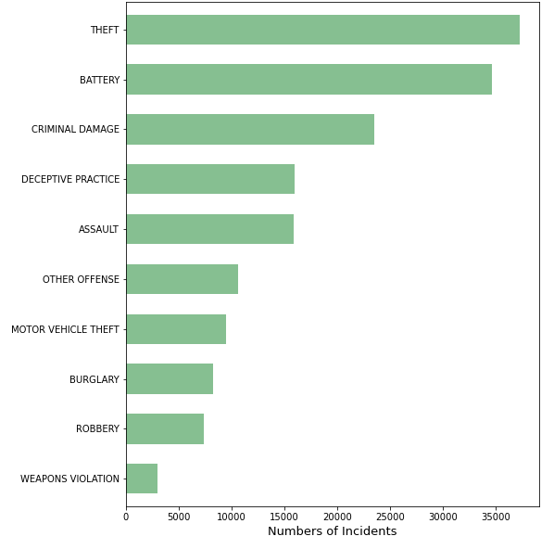
Top 10 Types of Incidents in Chicago Where Arrests were NOT Made

Slide 8
Choropleth map
A map that shows color differences based on the numbers of incidents in each community area in Chicago
Since the size of the original dataset was too big for this analysis, this choropleth map was created based on the first 1,000 incidents
Only incidents where arrests were made were included to create the map

Slide 9
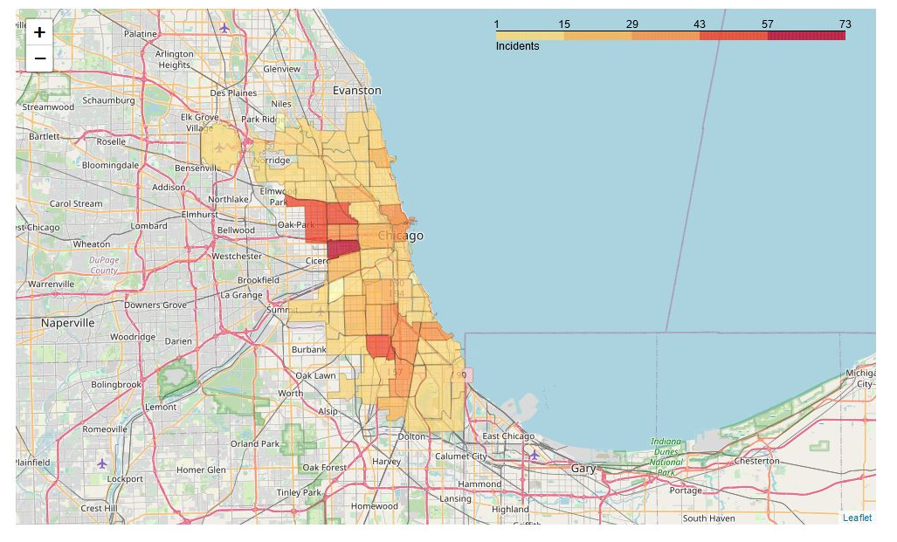
Choropleth map
More incidents occurred in western and southern neighborhoods (colored in red, orange, and dark yellow), compared to northern neighborhoods (colored in light yellow)

Slide 10
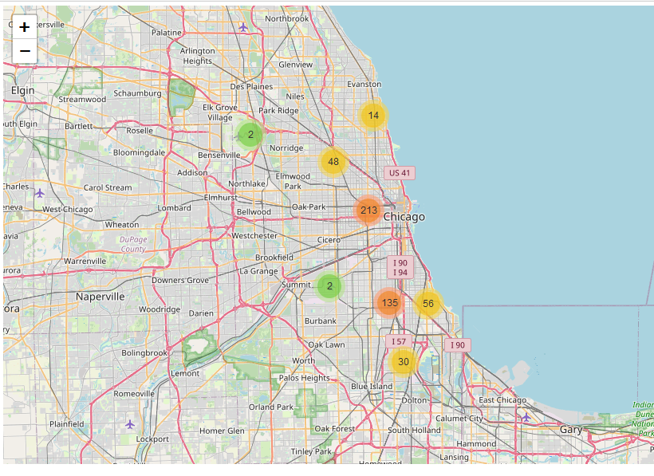
This map confirms that more incidents were reported in western and southern neighborhoods
NOTE: The first 500 incidents from the “Arrest were made” dataset were used for this map, due to the size of the original dataset

Slide 11
Additional Notes
More maps that I created are visible from the websites below (nbviewer)
Bar Charts: https://nbviewer.jupyter.org/github/Fuse0210/Chicago-Analyses-Crime-and-Education/blob/main/Chicago%20Crime%20Analysis%20%28Bar%20Charts%29.ipynb
Choropleth map: https://nbviewer.jupyter.org/github/Fuse0210/Chicago-Analyses-Crime-and-Education/blob/main/Chicago%20Crime%20Analysis%20%28Choropleth%20map%29.ipynb
Other maps: https://nbviewer.jupyter.org/github/Fuse0210/Chicago-Analyses-Crime-and-Education/blob/main/Chicago%20Crime%20Analysis%20%28Maps%29.ipynb
All the Python codes are listed on my Github page (https://github.com/Fuse0210/Chicago-Analyses-Crime-and-Education)

